Slide 1
Red Black Trees
Chaklam Silpasuwanchai

Slide 2
Readings
Chapter 13, Red Black Trees, Cormen et al. (2009). Introduction to Algorithms, Third Edition (3rd ed.). The MIT Press.
Chapter 9, Robert Lafore. (2002.) Data Structures and Algorithms in Java, Second Edition (2nd ed.). Sams, Indianapolis, IN, USA.

Slide 3
Red Black Trees

Slide 4
Red Black Trees
A self-balanced search trees
Guarantees basic operations take O(lg n) in the worst case
A red-black tree takes one extra bit of storage per node - its color, either black or red
Each node contains color, key, left, right, and p
If any node does not exist, the pointer contains the value NIL
A red black tree satisfy red-black properties
Every node is either red or black
The root and leaves are black
Every red node has black parent
From x to any leaves, each simple path should contain same amount of black nodes (i.e., black height) - number of black nodes of any path from node x down to leaf (not including x) denoted as bh(x)

Slide 5
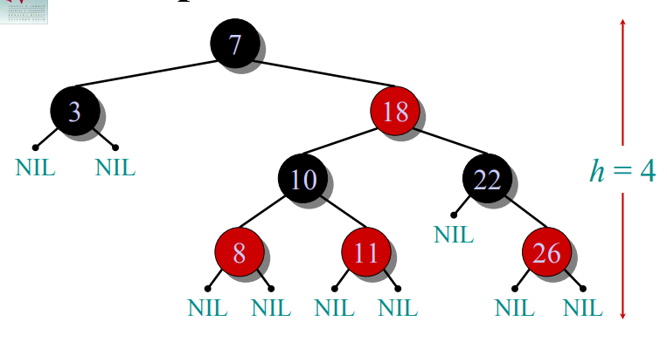
Example of a red black tree

Slide 6
Example of a red black tree
Every node is either red or black

Slide 7
Example of a red black tree
2. The root and leaves (NIL’s) are black.

Slide 8
Example of a red black tree
3. If a node is red, then its parent is black

Slide 9
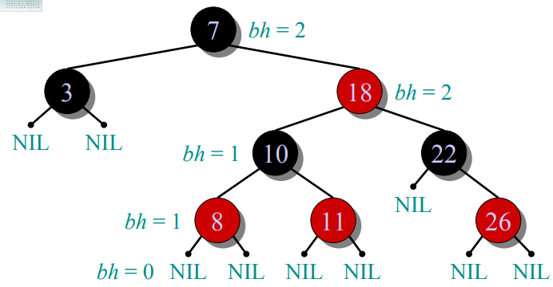
Example of a red black tree
4. All simple paths from any node x to a descendant leaf have the same number of black nodes = black-height(x)

Slide 10
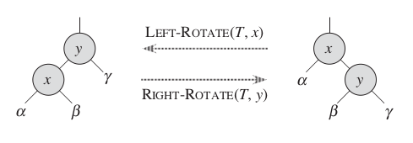
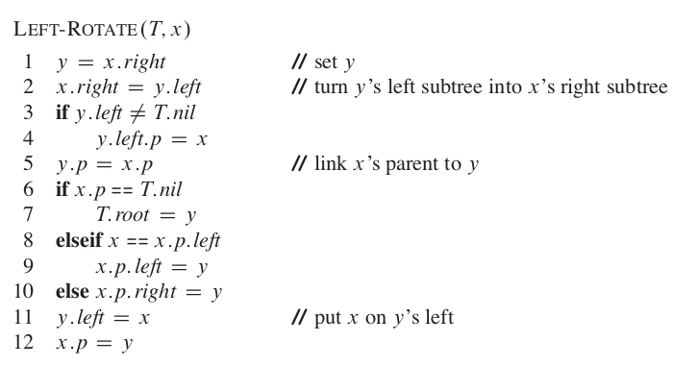
Red Black Trees - Rotations - O(1)

Slide 11
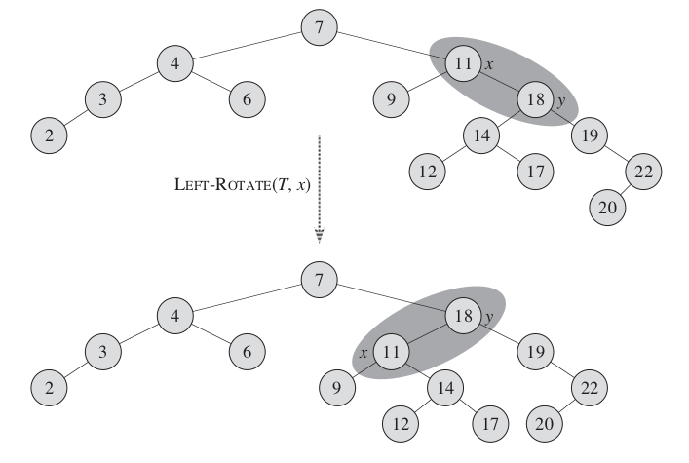
Red Black Trees - Rotations

Slide 12
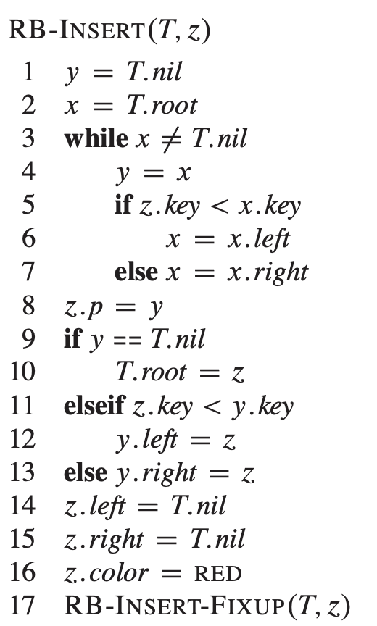
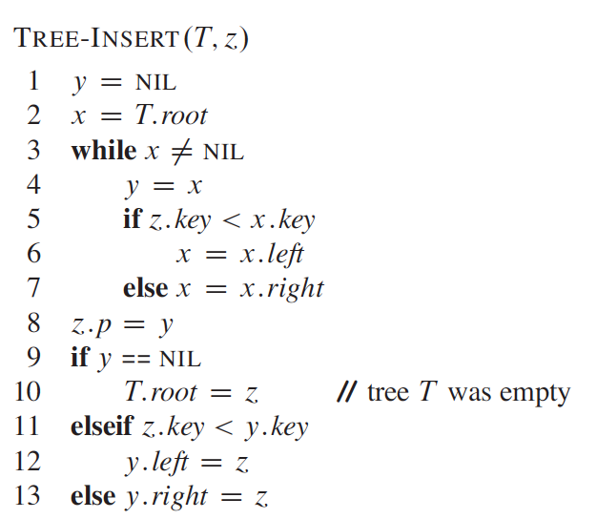
Red Black Trees
comparing RB Tree and normal binary tree insertion

Slide 13
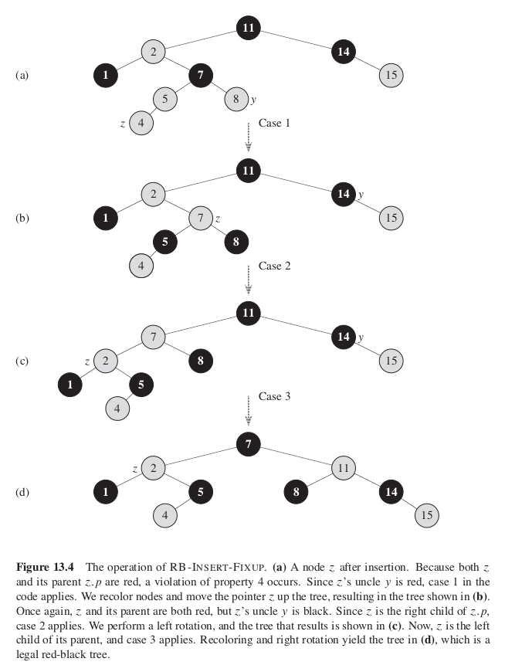
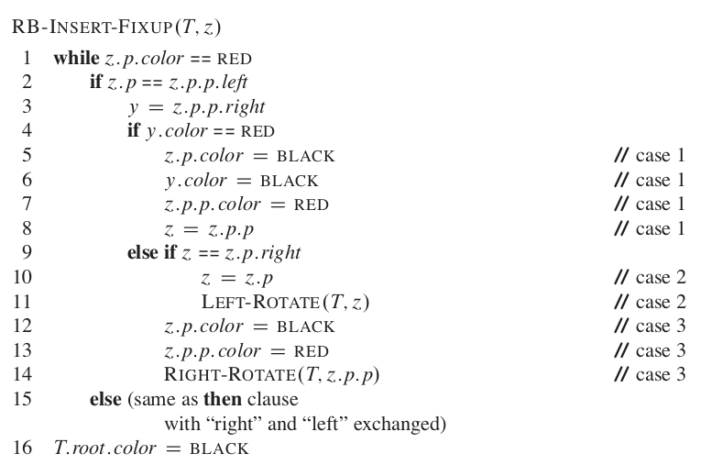

Slide 14
Exercises
CLRS 13.3-2
Show the red-black tree that results after each of the integer keys 41, 38, 31, 12, 19, 8 are inserted, in that order, into an initially empty red-black tree.
Clearly show the tree that results after each insertion (indicating the color of each node), and make clear any rotations that must be performed.

Slide 15
Exercises
41, 38, 31, 12, 19, 8

Slide 16
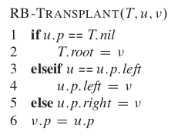
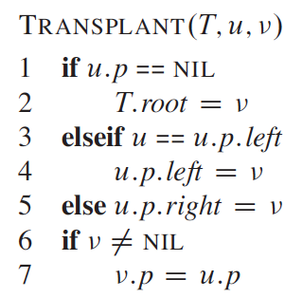
Red Black Trees - Deletion
comparing RB Tree and normal binary tree transplant
RB-TRANSPLANT differ in two ways:
Line 1 uses T.nil instead of NIL
Line 6 where v.p = u.p unconditionally, because v.p can point to sentinel NIL

Slide 17
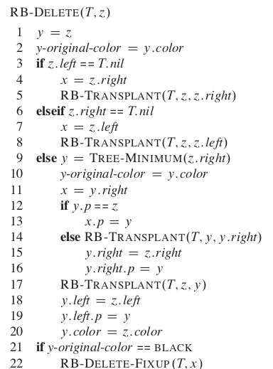
Red Black Trees - Deletion
Pointer y depicts the node either removed (line 1) or the node’s successor (line 9)
Save y’s original color in line 2 and 10
Keep track of node x that will move in place of y’s original position in line 4, 7, and 11
Line 5, 8 14 put x to the node’s y original position
Line 21 is the key - if y is black, we have to fix because we might violate some RB properties
If y is root and a red child of y becomes new root, we need to fix
If both x and x.p are red, then we got two adjacent reds
It may be possible to have one fewer black node

Slide 18
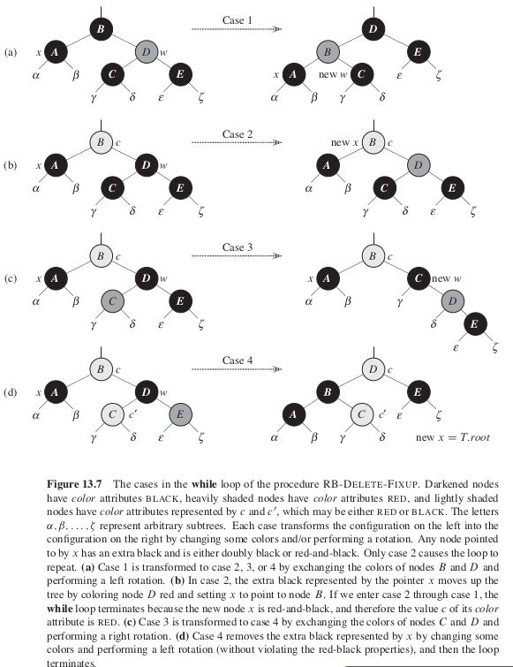
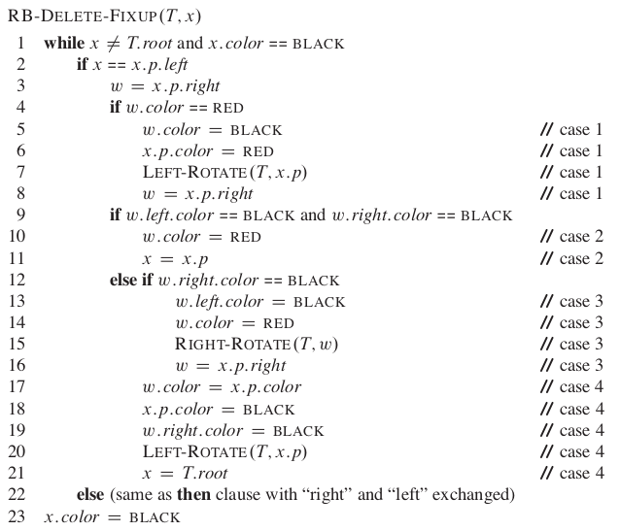
Red Black Trees - Deletion

Slide 19
Exercises
CLRS 13.4-3
In Exercise 13.3-2, you found the red-black tree that results from successively inserting the keys 41; 38; 31; 12; 19; 8 into an initially empty tree. Now show the
red-black trees that result from the successive deletion of the keys in the order 8; 12; 19; 31; 38; 41

Slide 20
Exercises
8; 12; 19; 31; 38; 41

